Slide 1
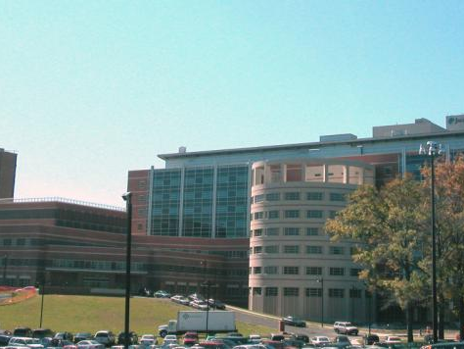
Welcome to Jacobi Medical Center
An outside view of Building 6, the newest addition to the Jacobi Medical Center.

Slide 2
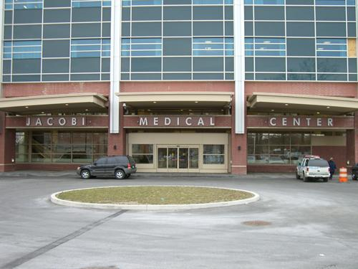
Main Entrance
Jacobi is a public city hospital, caring for a diverse and largely impoverished population. We recently expanded our facilities, adding an entirely new hospital, and a cardiac catheterization lab.

Slide 3
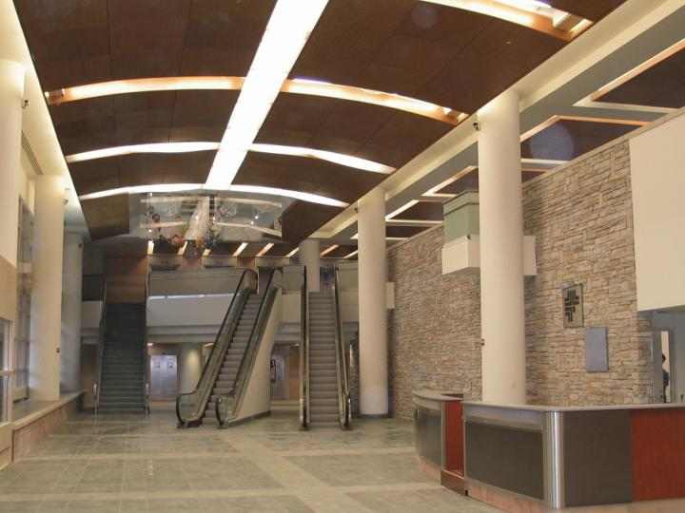
Lobby View
Family and Visitors enter the main entrance, register with security, and make their way to the interior of the hospital.

Slide 4
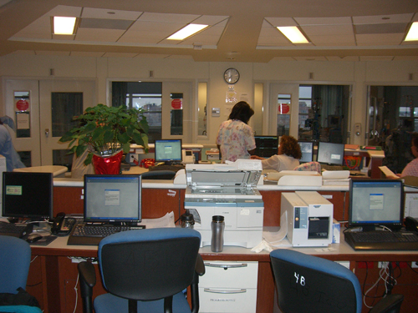
Intensive Care Units
Faculty and Staff do their work in one of the most technology-friendly hospitals in the nation. Literally 90% or more of the work you do and the data you retrieve is computer-based. Chart data, vitals, ekgs, radiology, daily notes, and consults are all available from our online systems.

Slide 5
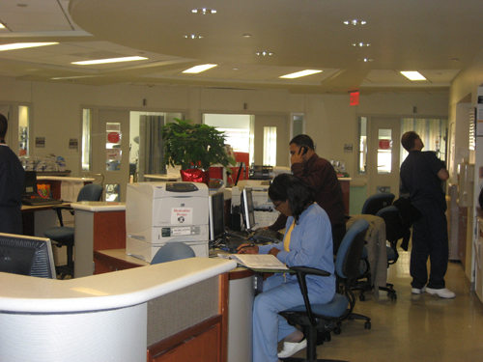
Intensive Care Units
All ICU’s are set up with the same panoramic layout, allowing staff to see all their patients with a sweep of their head. Work is done from a central “command area”.

Slide 6
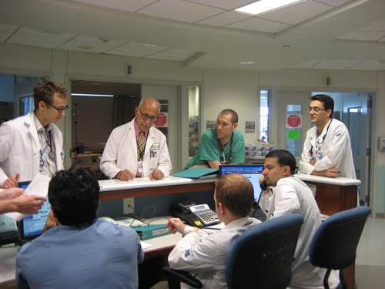
Intensive Care Units
Thanks to our centralized technologies, pertinent information can be called up quickly and easily during rounds. Here the CCU team can rapidly retrieve old chest films, EKGs, and echocardiographic data to work out a case of CHF.

Slide 7
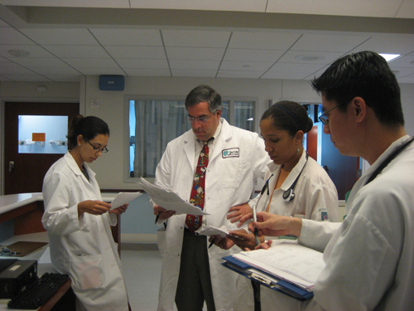
Medicine Wards
There are 6 teams responsible for the general medical floors. In addition, 3 specialty teams (Oncology, HIV/AIDS, and Pulmonary) care for patients on the general medicine floors.

Slide 8
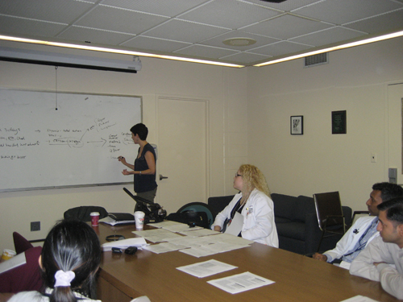
Conferences
Daily Conferences add to our residents’ education. Each day, conferences for all, and for specific groups (Residents, Interns, and Students) are available to complement the hands-on learning that happens on the wards.

Slide 9
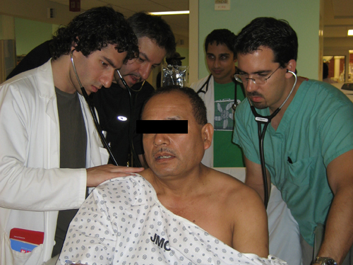
Team Work
On morning rounds, attendings, residents and students gather to discuss and examine their patients. This is a great time for hands-on learning.

Slide 10
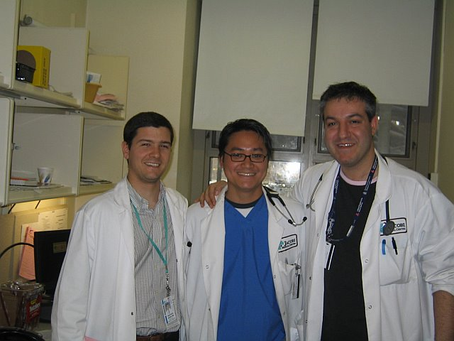
Team Work
One of Jacobi’s great strengths is its residents, who hail from all over the world. They literally bring a world of experience to their work and their patients. We teach to and learn from each other every day.

Slide 11
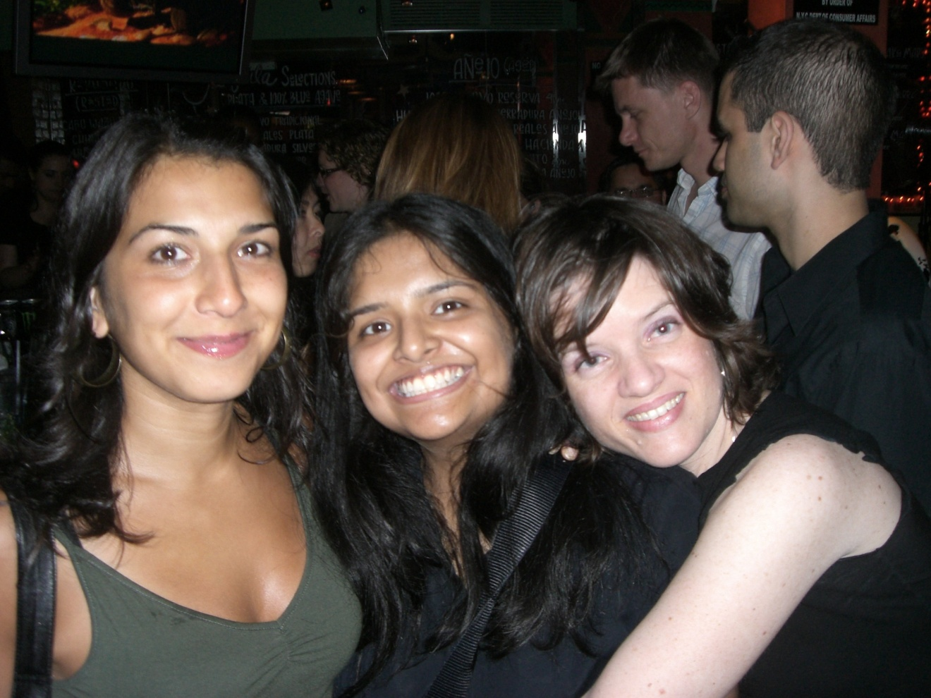
Team Work
And every once in a while, we even get away from the hospital and experience the joys of Manhattan.

Slide 12
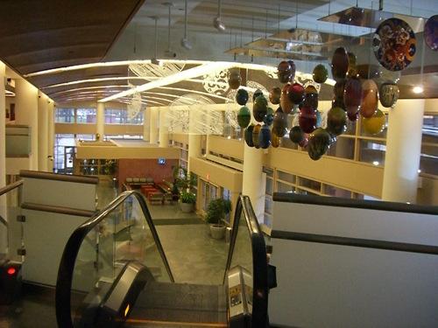
We hope you’ve enjoyed the tour.
This is the way out.

